Slide 1
Traditional Data Store VS Version Control System
Imagine two programmers, Alice and Bob, working on a software project. Initially, they share code via email or using cloud storage
They frequently face difficulties such as making changes to the same file. This often results in one person's changes overwriting the other's, causing frustration and lost work.
they often accidentally overwrite each other's work.
All these issues can be solved by using Git

Slide 2
GIT & GITHUB
Imagine Git as The Personal Notebooks
Imagine GitHub as The Central Library
each contributor has a personal notebook. As they work on writing or editing sections of a book, they note down their changes and ideas in their notebook.
They can flip back through their notebook to see all the changes they've made, revert to earlier changes if needed.
The library represents GitHub, a central location where contributors can store and share their work. To update the library with their latest changes, contributors bring their notebooks and "publish" their updates.

Slide 3
GIT
Git is a popular version control system used to manage source code and other files in software development projects.
Git allows developers to track changes made to code over time, collaborate with others on the same codebase, and easily roll back changes if needed.
Git is widely used in software development, both in open source and commercial projects, and is supported by a large ecosystem of tools and services.

Slide 4
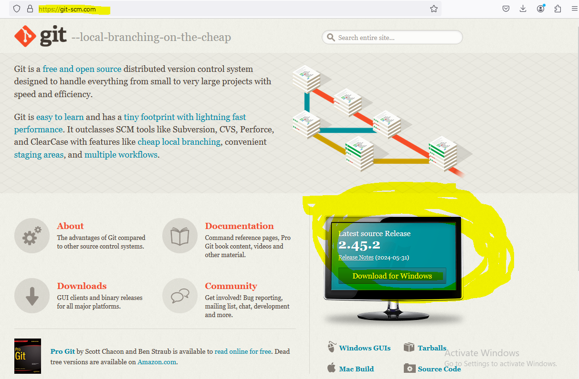
How to use git

Slide 5
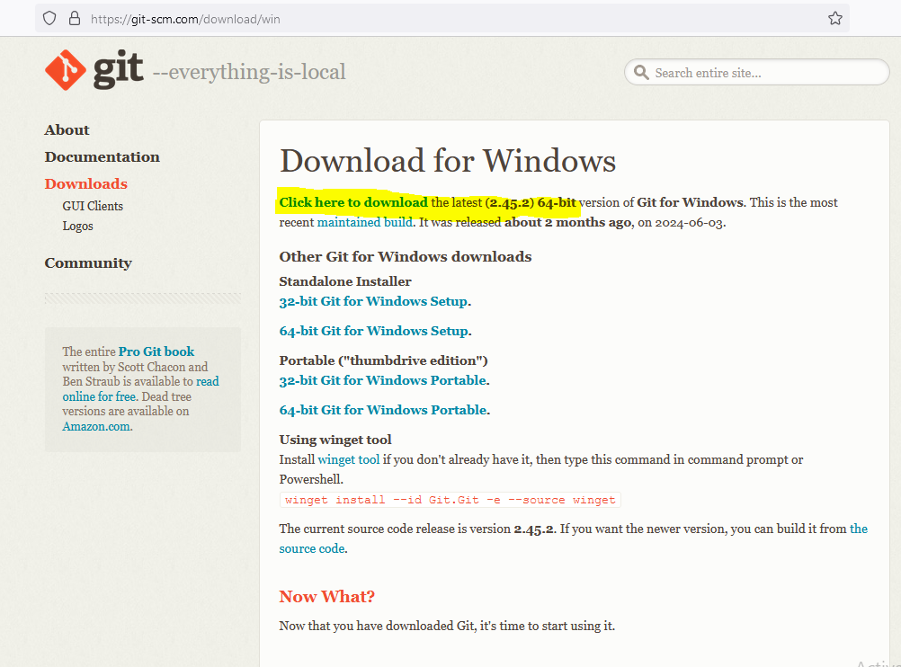

Slide 6
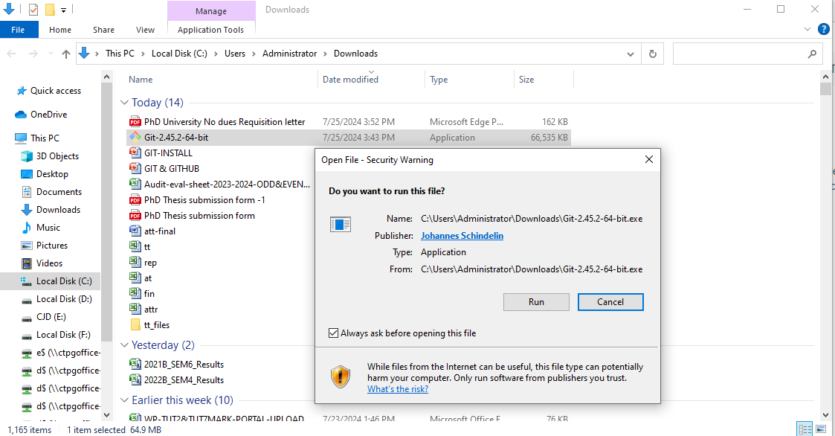

Slide 7
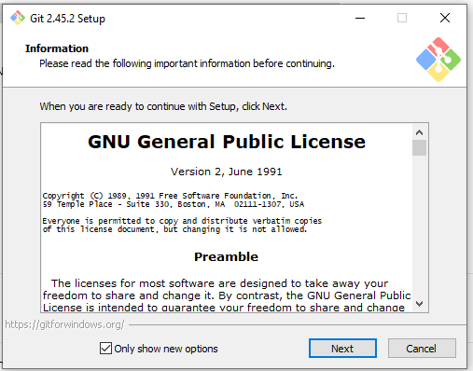
CHOOSE NEXT

Slide 8
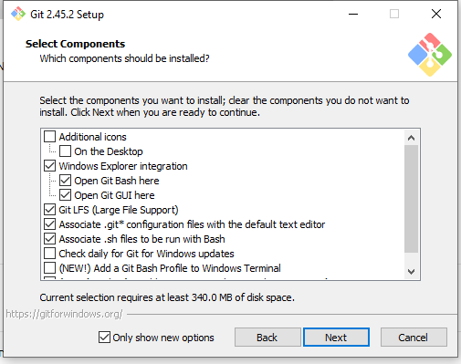
CHOOSE NEXT

Slide 9
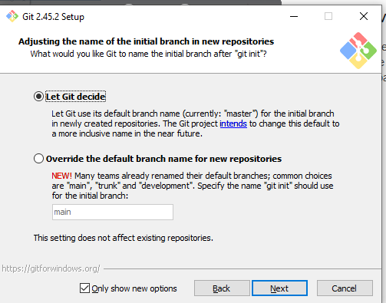
CHOOSE NEXT

Slide 10
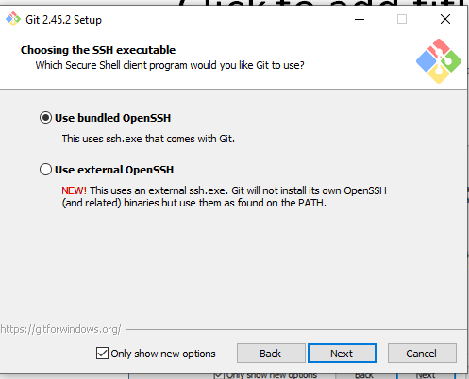
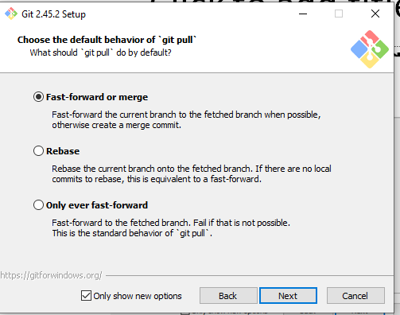
CHOOSE NEXT

Slide 11
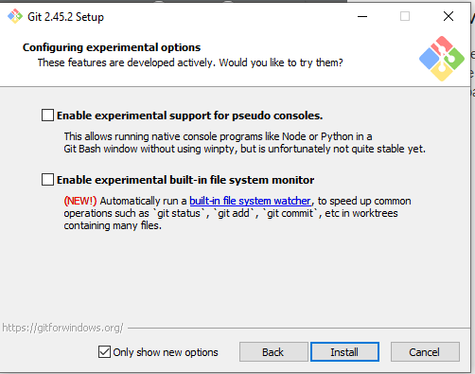
CLICK INSTALL

Slide 12
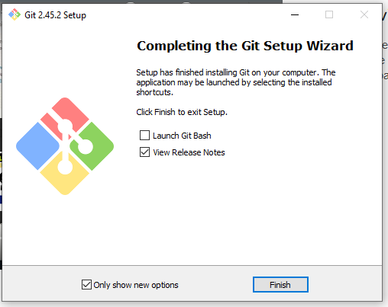
CLICK FINISH

Slide 13
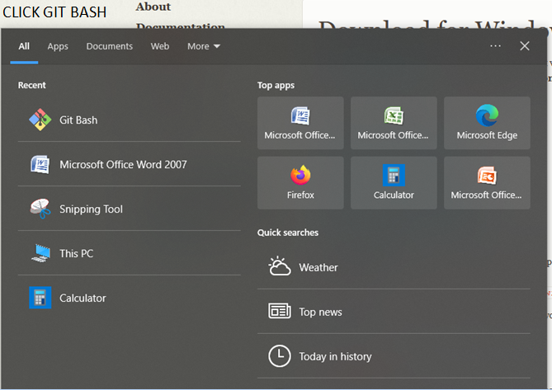
CLICK GIT BASH

Slide 14
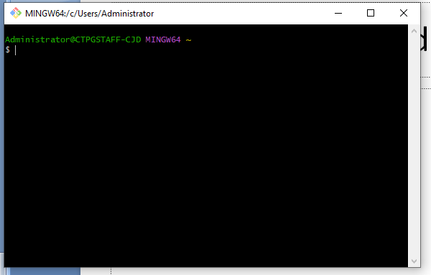
COMMAND PROMPT OPENED

Slide 15
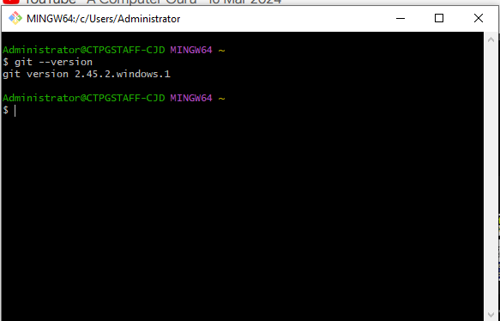
CHECK VERSION : git --version

Slide 16
GIT HUB
GitHub is a web-based platform that provides a collaborative environment for software development projects.
It is built around the Git version control system, which allows developers to track changes in their code over time and collaborate with other developers on the same codebase.
GitHub is widely used in the open-source software community, but it is also used by companies and organizations for their own internal software development projects.

Slide 17
GitHub provides features such as project management tools, issue tracking, code review, and collaboration tools, which make it easier for developers to work together on complex software projects.
It also serves as a platform for hosting code repositories, which can be shared with other developers around the world.
It has become an essential tool for modern software development, enabling developers to work more efficiently and collaboratively.

Slide 18
ADVANTAGES OF GITHUB
Community
Security
Code Review
Collaboration
Version Control

Slide 19
HOW TO USE GITHUB
Create an account: Visit GitHub's website and create a free account.
Create a repository
Upload your code
Collaborate

Slide 20

CLICK Sign up for GitHub

Slide 21
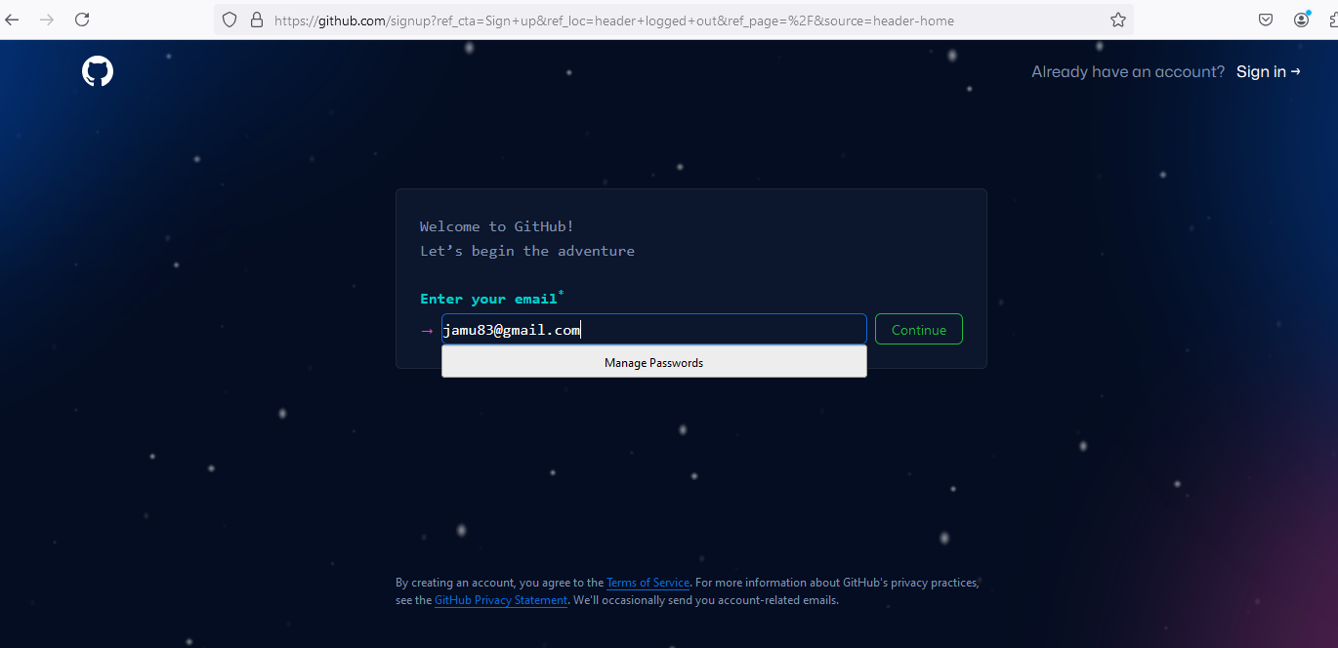
Enter your Email & Click Continue

Slide 22
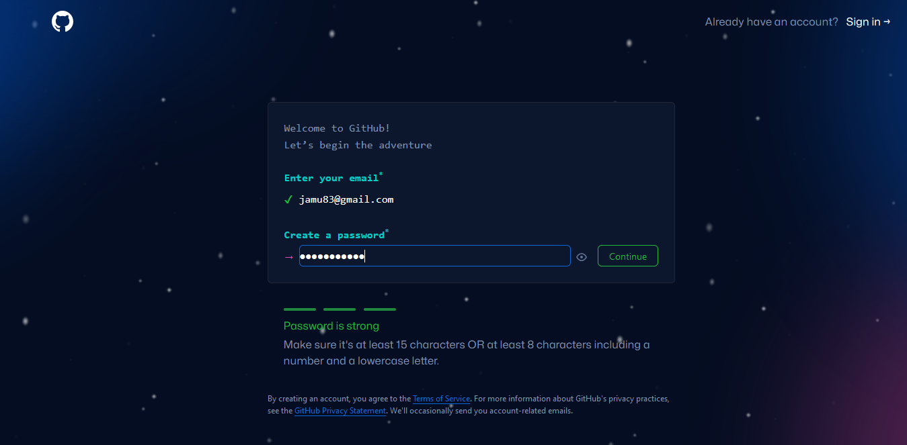
Create a Password : Make sure it's at least 15 characters OR at least 8 characters including a number and a lowercase letter.

Slide 23
CREATE USERNAME
Username may only contain alphanumeric characters or single hyphens, and cannot begin or end with a hyphen.

Slide 24
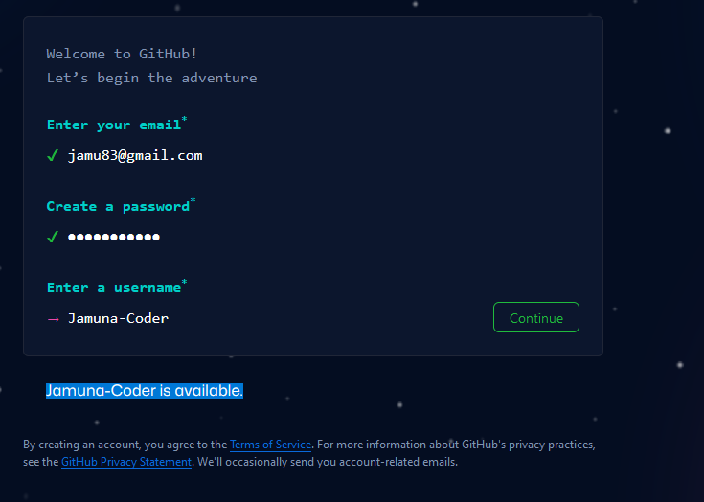
Create Username

Slide 25
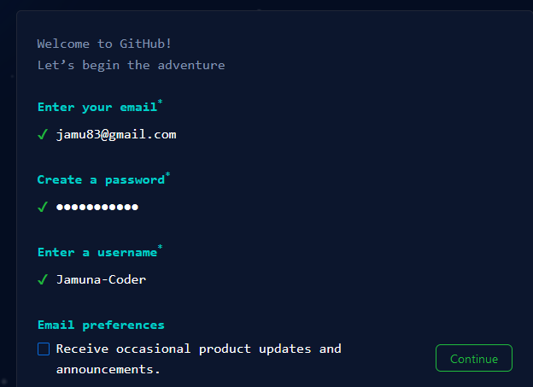
Click Continue

Slide 26
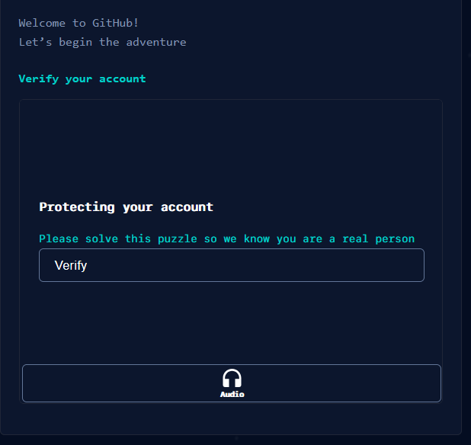
Click Verify

Slide 27
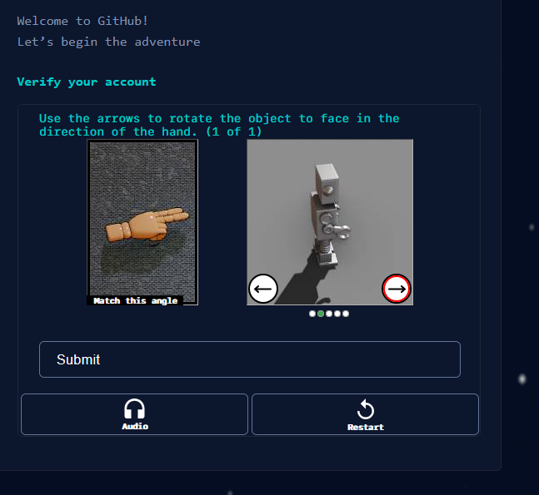
Solve Captcha

Slide 28
E-Mail Verification
GitHub launch code! Will be sent to your registered E-mail
Enter the code

Slide 29
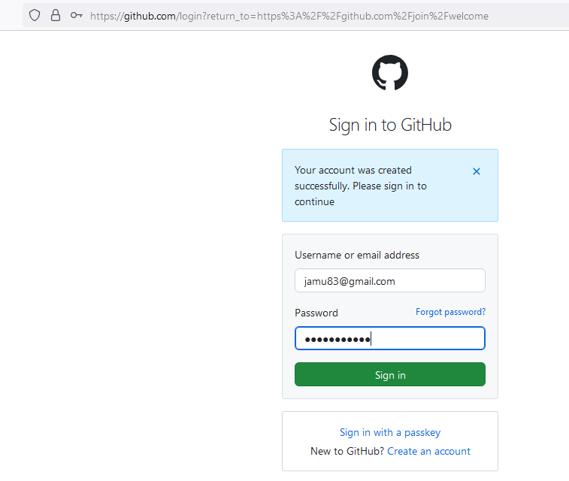
Login to your Github account

Slide 30
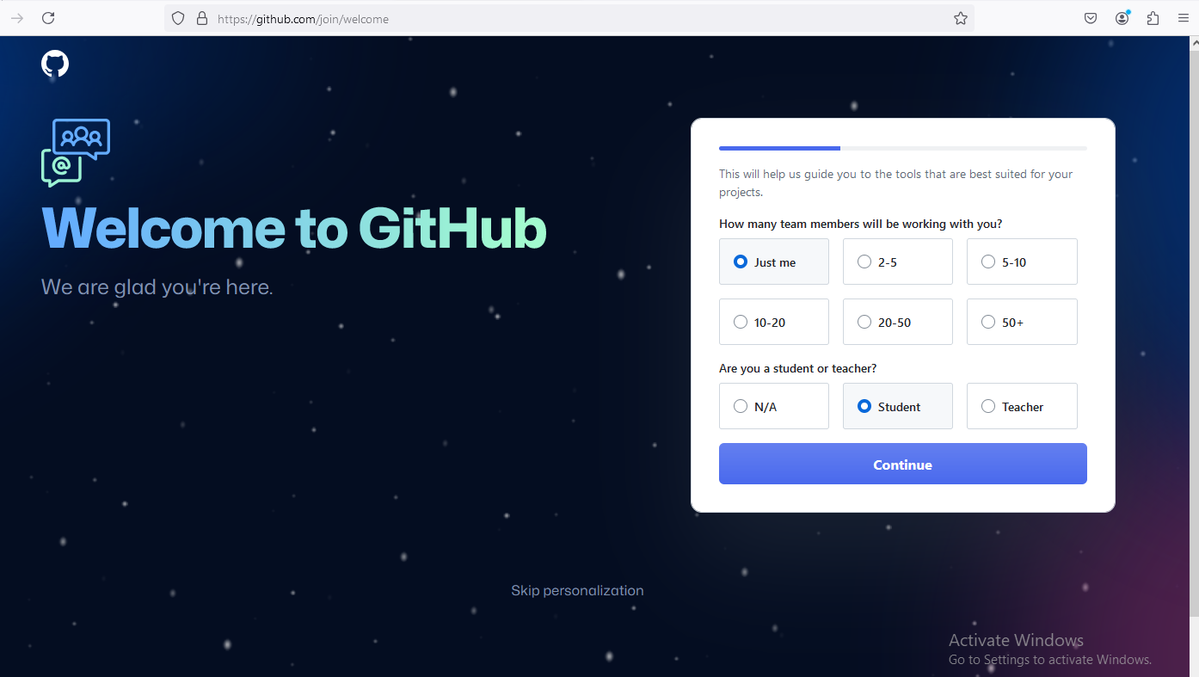
Click Just me & Student Option

Slide 31
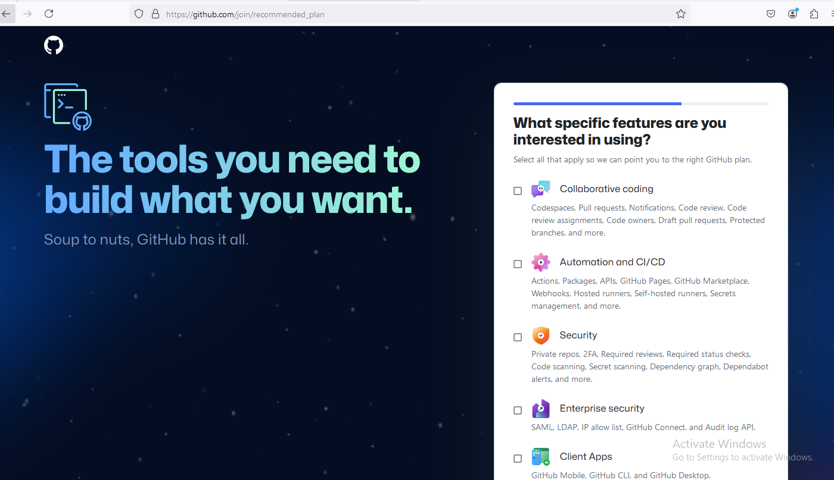
You can SKIP this page

Slide 32
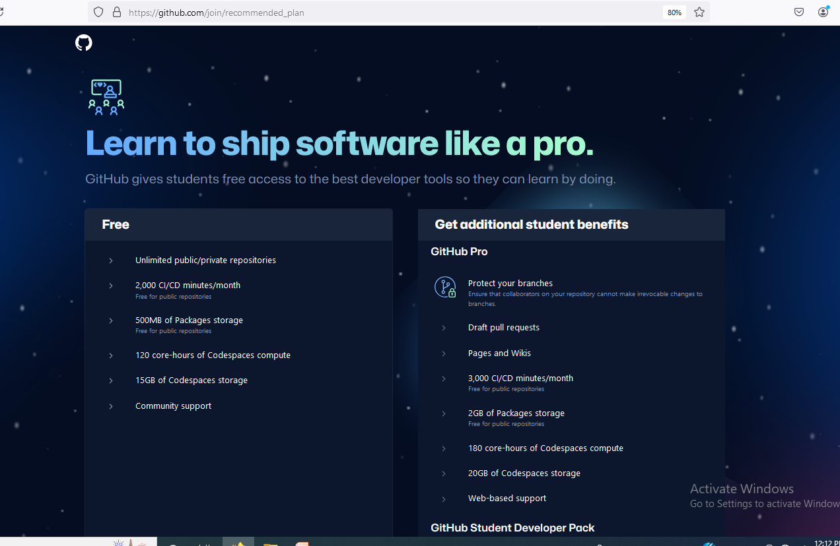
Two Pricing Plan : 1. Free 2. GitHub Pro

Slide 33

Click Continue for Free

Slide 34
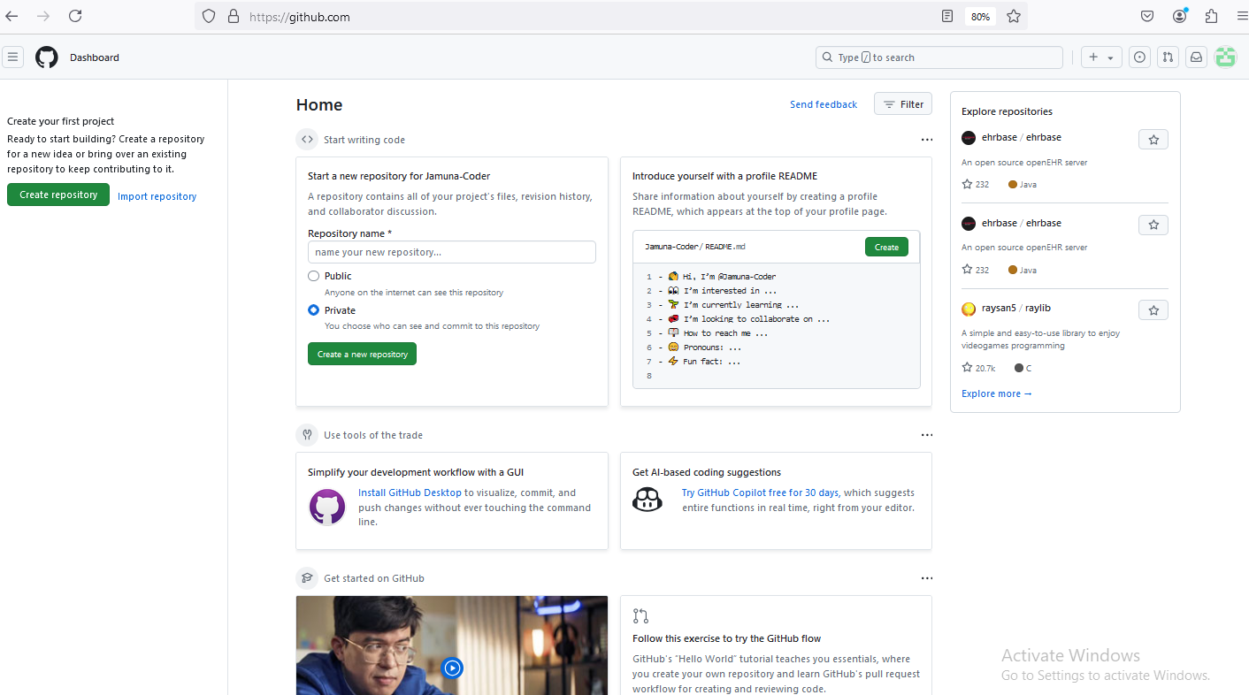
Home Page

Slide 35
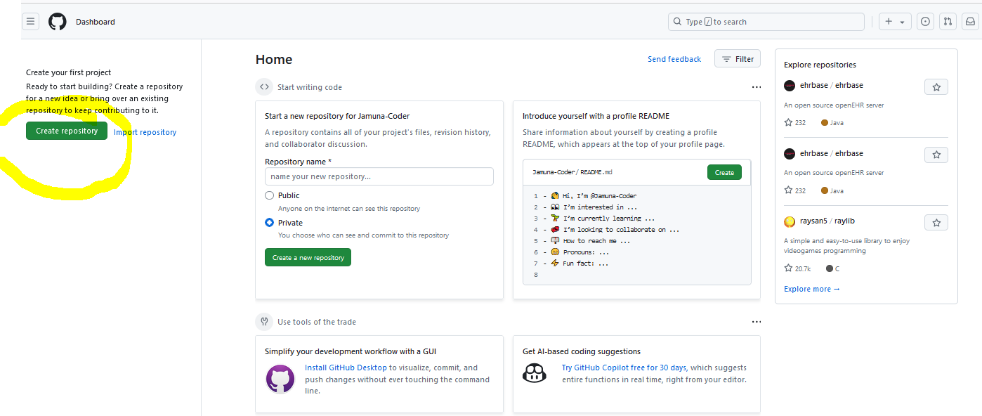
Choose Create Repository in Github

Slide 36
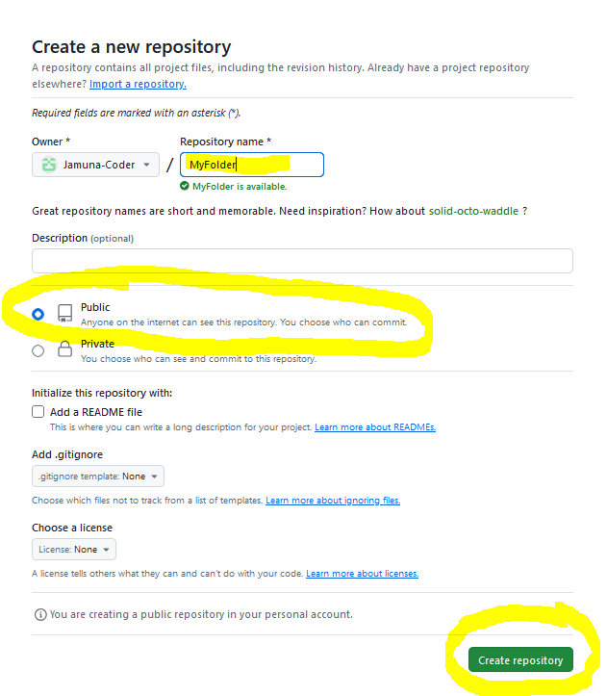
Create a new repository

Slide 37
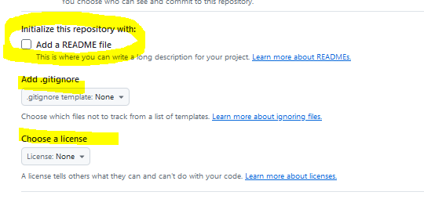
Other Options
Notes:
Add a README file : Don’t Click this , Information about project is shown here
Gitignore: File contains the names of Files and Folders that Git Wants to Omit while pushing the code( Example : if the code size is too big or helping folders- that’s need to be ignored can be included here)

Slide 38
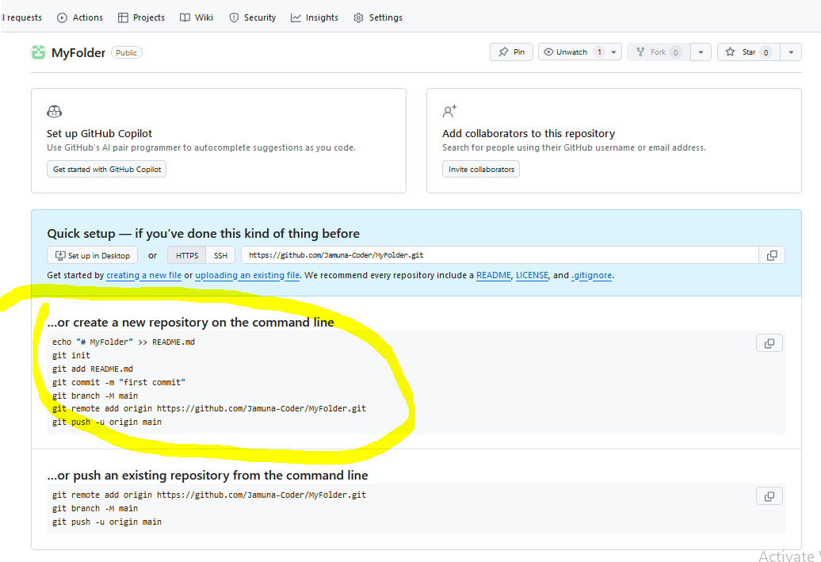
Commands to be executed In VisualStudio Code editor

Slide 39
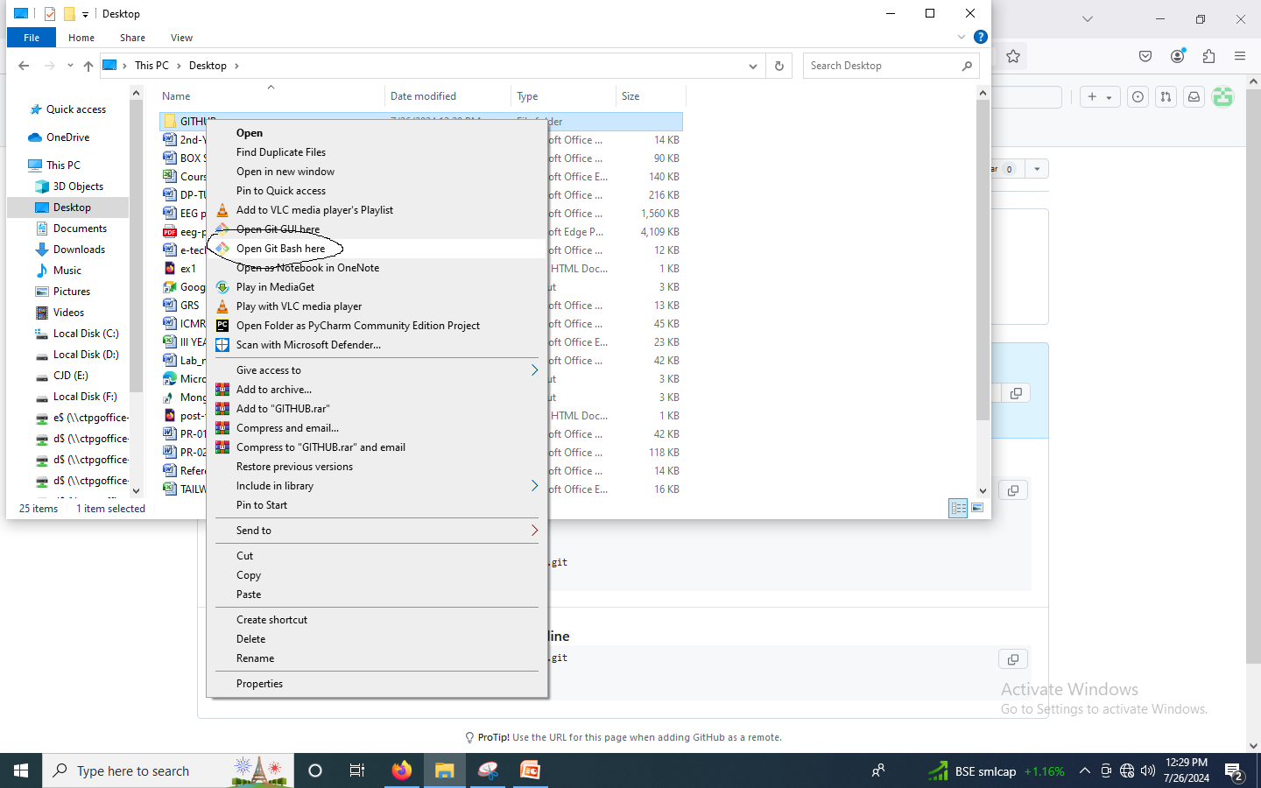
UPLOAD
Notes:
Choose the Folder you created to Upload in Github & Right Click it → in that choose → Open Git Bash here

Slide 40
Connect GIT with GITHUB
Run
git config --global user.email you@example.com
git config --global user.name "Your Name"

Slide 41
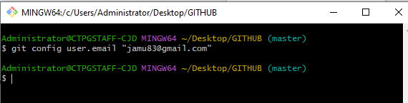
git config user.email “jamu83@gmail.com”

Slide 42
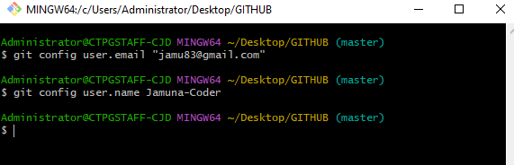
git config user.name "Your Name"
Notes:
git config --global user.name “Jamuna-Coder"

Slide 43
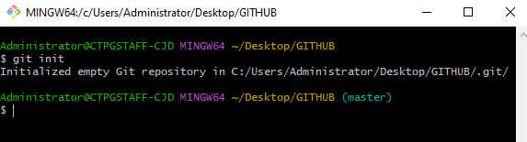
Give the Command : git init

Slide 44
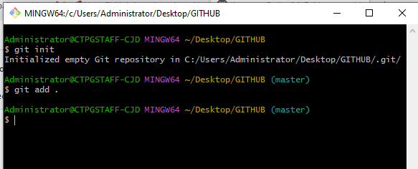
Give the Command : git add .
Notes:
First Everything will be staged/loaded in LOCAL REPOSITORY then after PUSHING it will be moved to GITHUB repository.
To upload the folder into local repository
Dot stands for current folder

Slide 45
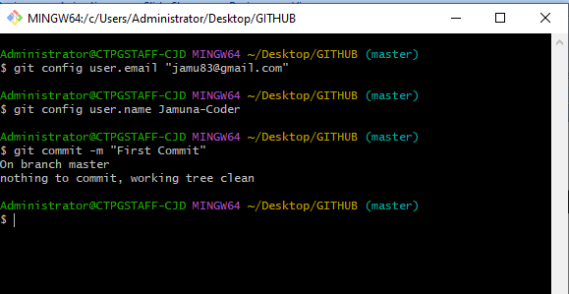
git commit -m "first commit"
Notes:
git commit -m "first commit“ : to commit/save the file in LOCAL REPOSITORY

Slide 46
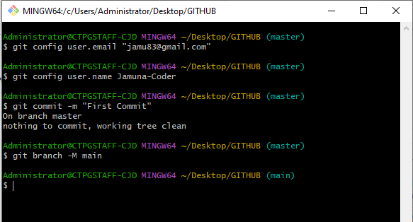
git branch -M main
Notes:
git branch -M main : used to MAP BRANCH : example 3 programmers working in a single project each programmer can given one branch.
Students default is main branch

Slide 47
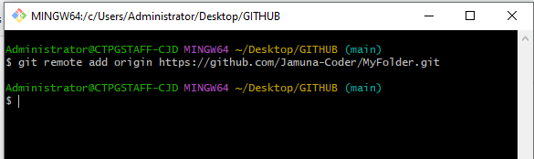
git remote add origin https://github.com/Jamuna-Coder/MyFolder.git
Notes:
git remote add origin https://github.com/Jamuna-Coder/MyFolder.git

Slide 48
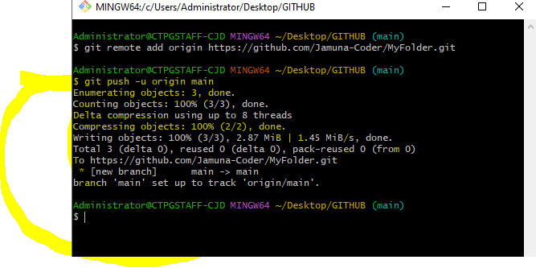

Slide 49
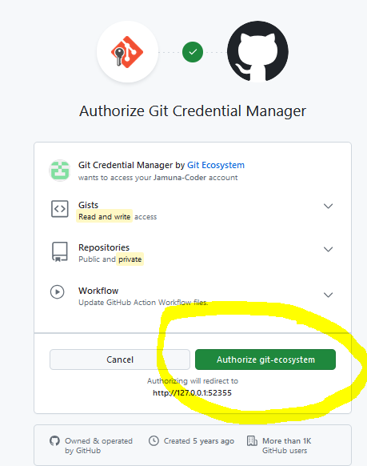

Slide 50
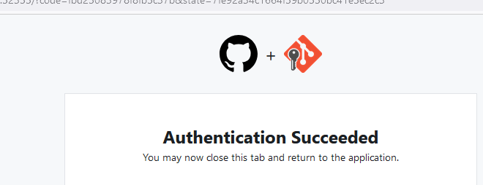

Slide 51
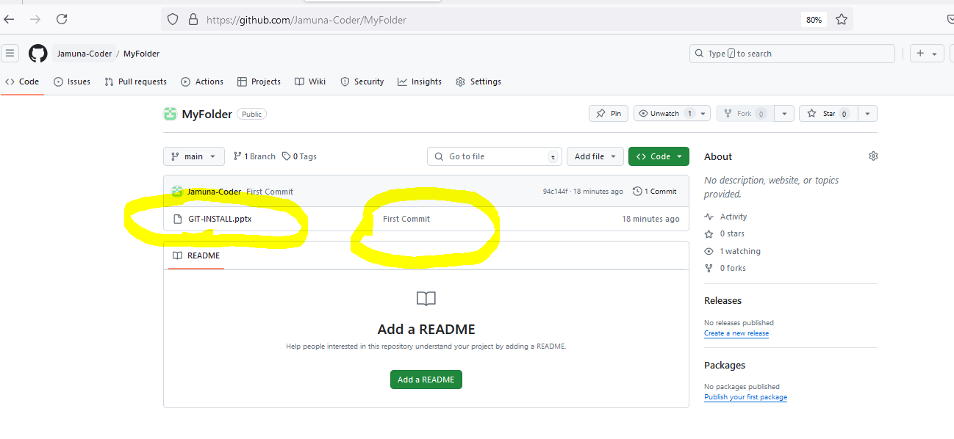

Slide 52
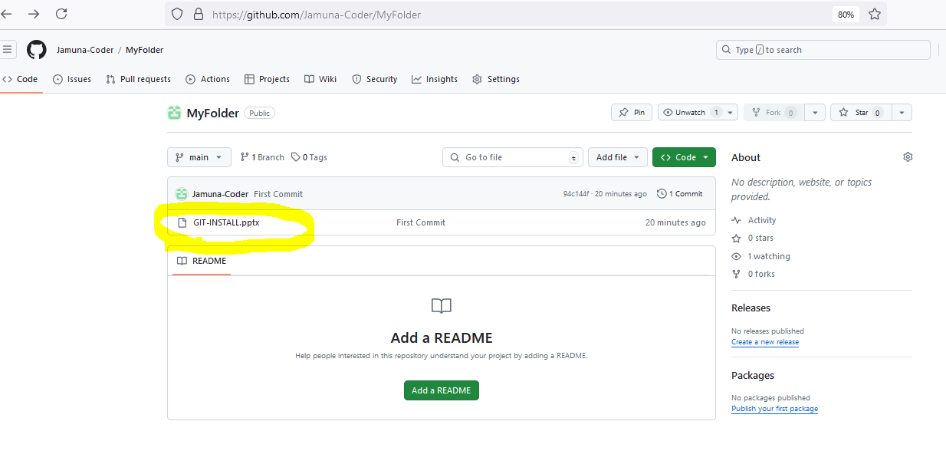
To Remove/Delete Uploaded File
Notes:
Click the file to remove

Slide 53
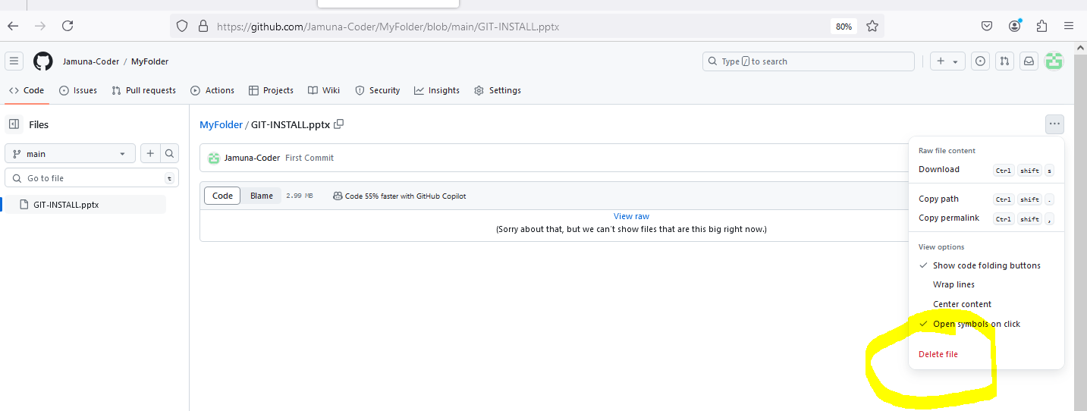
Click the three dots in Right Corner & Then Choose Delete File

Slide 54
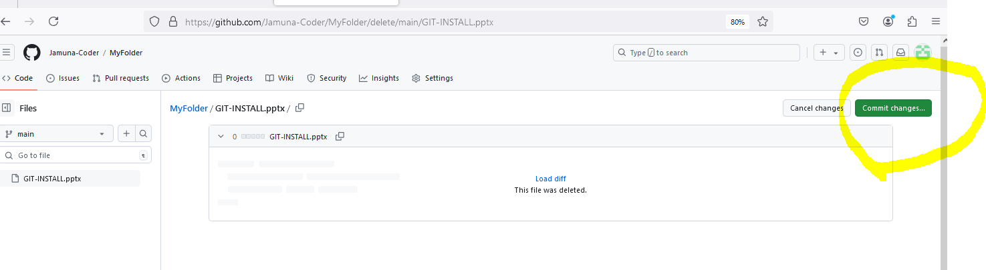
Click Commit Changes

Slide 55
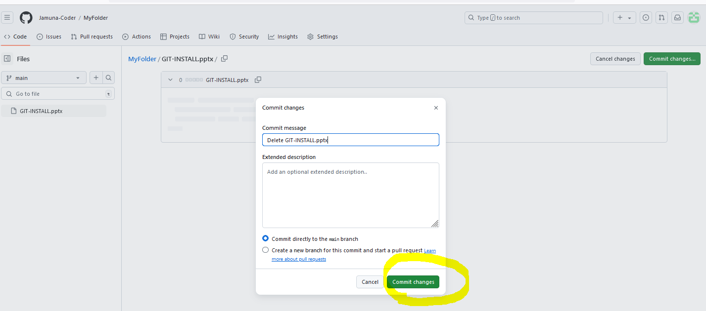
Enter Commit & Continue

Slide 56
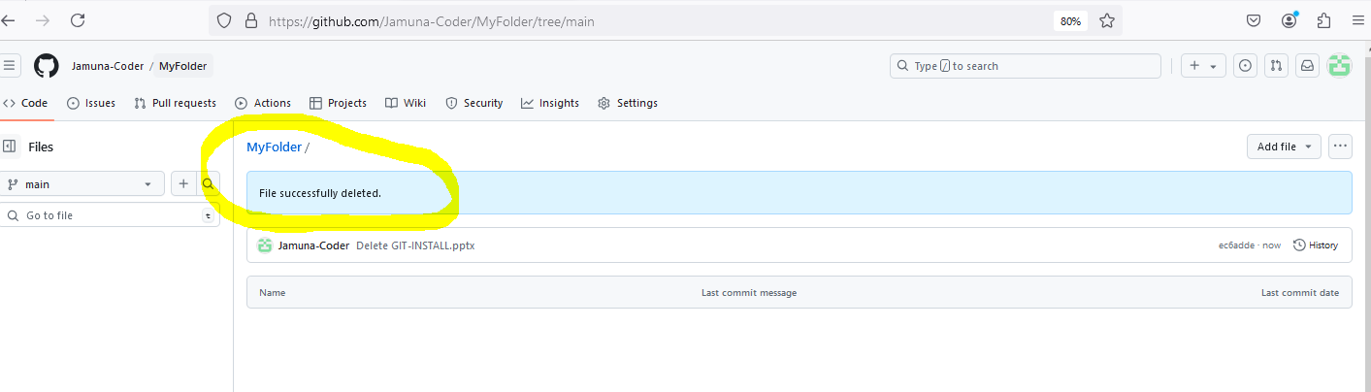

Slide 57
Commands used when we ADD new file to the existing folder
git add .
git commit –m “Message”
git push –u origin main

Slide 58
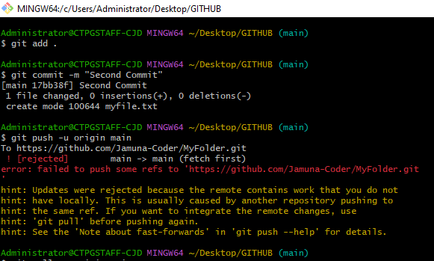
Error sample
Notes:
If a file modified/add or deleted in GITHUB use git pull in gitbash

Slide 59
NOTE
If a file modified/add or deleted in GITHUB use git pull in gitbash

Slide 60
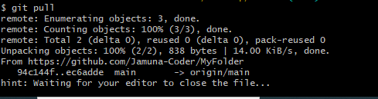
Git pull – screen shot
Notes:
After executing the command a note editor will open enter :qa to exit the note editor & continue

Slide 61
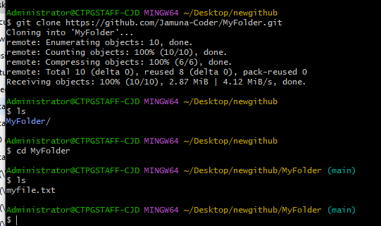
Sharing your GITHUB repository - git clone url

Slide 62
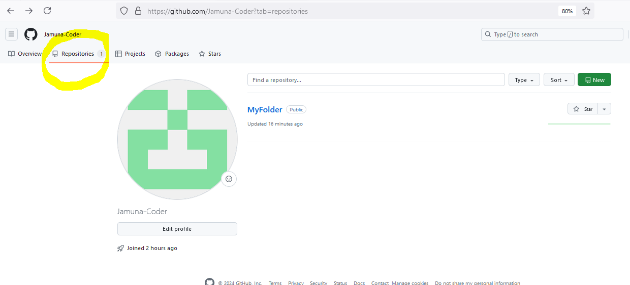
url is taken from

Slide 63
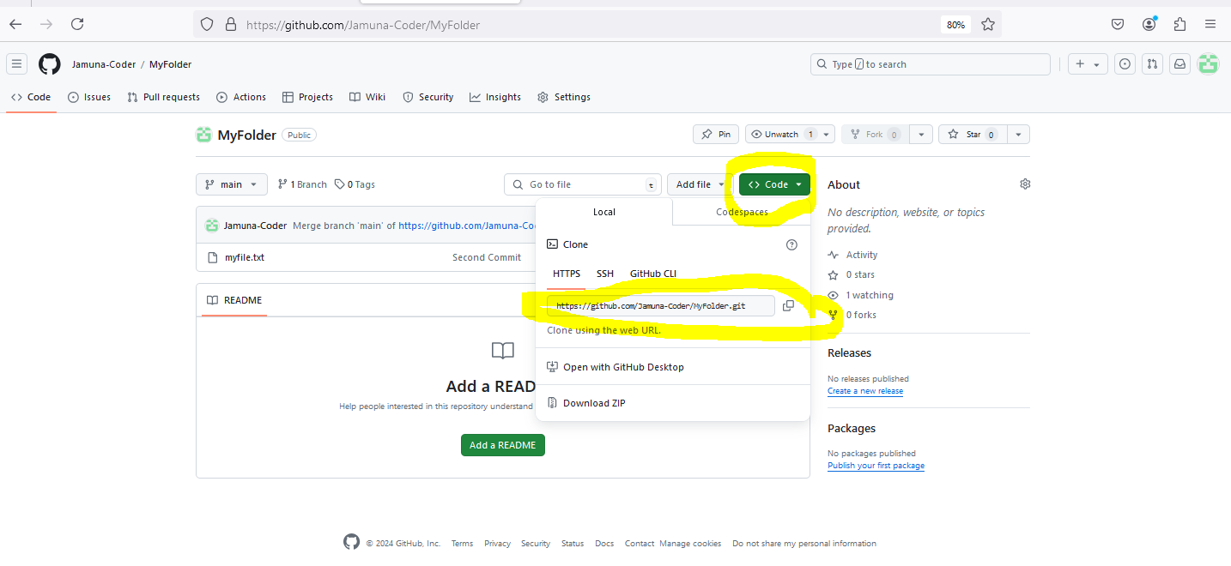
URL

Slide 64

To GET your GITHUB id
Notes:
In home page click the icon highlighted

Slide 65

Choose your profile

Slide 66

Choose the id from address bar

